Slide 1
Coaching SKILLS FOR LEADERS
With Jen Buck
Jenbuckspeaks.com/heliae

Slide 2
WHY DOES COACHING MATTER?
- Developing the next generation of leaders is the top challenge for the majority of CEO's
- 63% of millennials believe they aren’t being fully developed as leaders by their employers for management positions
- 83% of businesses say it’s important to develop leaders at all levels. Yet less than 5% of companies have implemented leadership development across all levels
- 47% of CEO's surveyed predict there will be a shortage of leadership or executive-level skills in the future

Slide 3
Review!
WHEN THERE’S A LACK OF ACCOUNTABILITY WE SEE:
Lacking interest in work, and in the well-being of the team.
Blaming others for mistakes and failures.
Missing deadlines.
Regularly complaining about unfair treatment; engaging in self-pity, deflecting responsibility,
feeling buried, argumentative toward leadership.
Avoiding taking initiative, and being dependent on others for work, advice, and instructions.
Making excuses regularly – may often say "It's not my fault," or "That's unfair."
Lacking interest in their work, and in the well-being of the team.
Blaming others for mistakes and failures.
Missing deadlines.
Avoiding challenging tasks and projects; and not taking risks.
Regularly complaining about unfair treatment by team leaders and team members – and engaging in self-pity.
Avoiding taking initiative, and being dependent on others for work, advice, and instructions.
Lacking trust in team members and leaders.
Making excuses regularly – they may often say "It's not my fault," or, "That's unfair."

Slide 4
Before you engage in coaching
Review!
Look at the person in the mirror; your team is a reflection of you.
01
Have you created a process for them to succeed and thrive?
02
Have they been trained correctly and given the correct tools?
03
Are you holding them accountable positively?
04
Do you have a plan that will alleviate their pain point?
05

Slide 5
COMMUNICATION FACTS
75% of our waking hours are spent in some form of communication.
WRITING
9%
READING
16%
TALKING
30%
LISTENING
45%
8 nonverbal
elements
FACIAL
EXPRESSIONS
BODY LANGUAGE
HAPTICS
GESTURES
PROXEMICS
APPEARANCE
EYE GAZE
PARALINGUISTICS
10% of conflicts are due to a difference in opinion.
90% are due to the wrong tone of voice.

Slide 6
Understand Their
Thinking Styles
Authority-driven
Relationship Driven
Consistent
Results Focused
Emotional
Intuitive
Data Driven
Sensory
Customize Your
Coaching Style

Slide 7
Develop Your Coaching Language
to Perfect Your Coaching Skills
I’ve noticed
I’m concerned
I’ve heard
I’m worried
I would like to see the following
I would appreciate more information on
Can you help me understand
HELIAE

Slide 8
Review!

Slide 9
Develop Your Questioning Skills to Perfect Your Coaching
WHY
What can you tell me about this?
How did this come about?
How can I help mitigate that next time?
Where did you find that information?
Why did you feel that was the best choice?
Who else is concerned about this?
What can I do to support you further?
When did this problem start?
How can I help ensure this doesn’t happen again?
WHAT
WHO
WHEN
HOW
WHERE

Slide 10
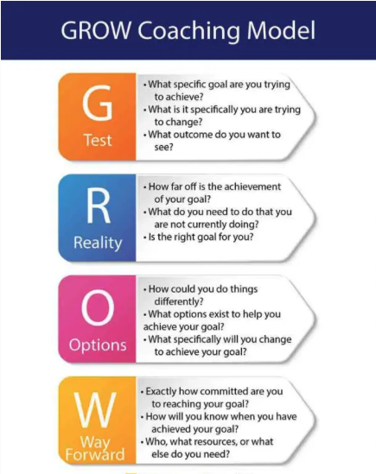
Goal

Slide 11
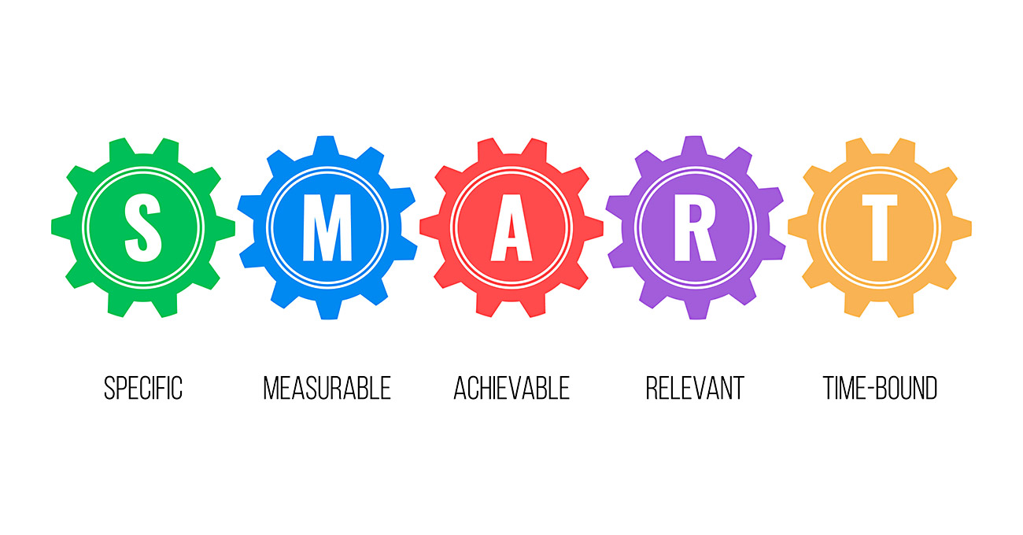

Slide 12
Great Leaders Are Always Accountable Leaders
1. Be accountable to your team
2. Be the right example 3. Address issues of conflict/fear
4. Coach regularly and often 5. Qtip/ Quit taking it personally 6. Build comfort with teammates 7. Commit to a No Judgment Zone 8. Be willing to accept feedback
9. Be willing to delegate

